Slide 1

Project 2 – Predicting restaurant tips using predictive analytics in Microsoft Excel
Submitted By: Epsa Kapur

Slide 2

OBJECTIVE
To use excel to predict restaurant tips

Slide 3
DESCRIPTION
The dataset in file Restaurant Tips Project dataset.xlsx contains tips data for different customers. The following are the features in the dataset:
Gender- gender of the customer
Smoker- indicates if the customer is a smoker or not
Day- day of the restaurant visit
Time- indicate whether the tip was for lunch or dinner
Size- number of members dining
Total Bill amount- bill amount in USD
Tip- tip amount in USD

Slide 4
PROBLEM STATEMENT
Build regression model to predict restaurant tips given input values with the mathematical equation for predicting the value of the tips

Slide 5
TASKS
The following project tasks were performed in excel:
Used the restaurant tips file for the analytics using Excel and found out if there are any missing values and clean the data.
Encoded the categorical variables to numeric values using IF conditions.
Found the features that are independent and dependent.
Identified which predictive problem is needed and build an appropriate model with the dataset.
Calculated the predicted and actual tips values.
Calculated the RMSE(Root Mean Square Error) of the model. RMSE is the root of the mean of square errors.

Slide 6
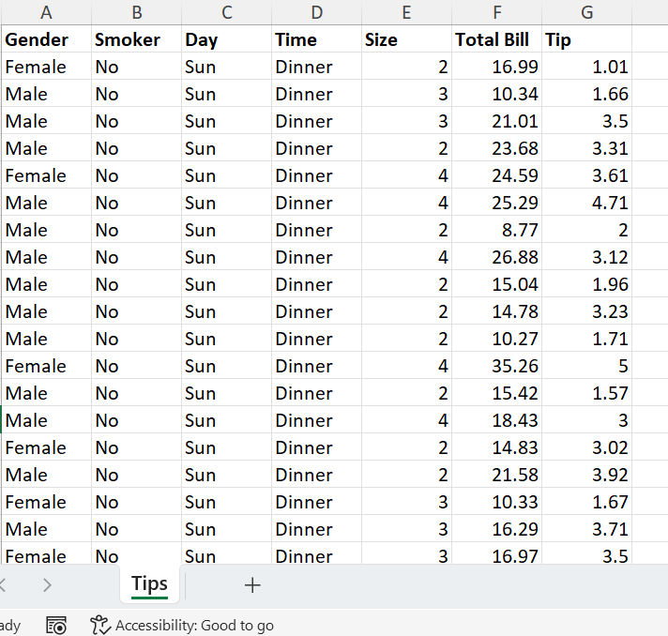
Clean the Data
All the data that are not numerical need to be converted to “0” or “1”. In this project, Gender, Smoker, Day, and Time need to be converted to “0” and “1” and we will clean them one by one in the next slides

Slide 7
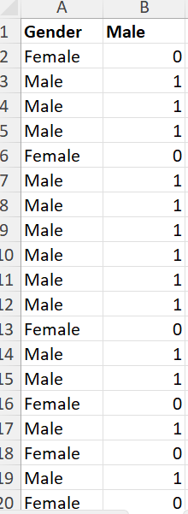
Clean the Data
To clean the data for “Gender” column, since there are only two options – Female and Male , we will need to add (n-1) columns, and in this case, it will be 2-1 = 1 column. We will add an additional column “Male” and apply the IF condition which is =IF(A2 =“Male”, 1, 0) and we will get the results as follows

Slide 8
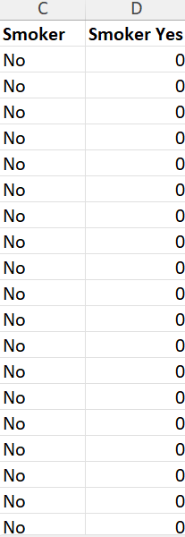
Clean the Data
To clean the data for “Smoker” column, since there are only two options – Yes and No , we will need to add (n-1) columns, and in this case, it will be 2-1 = 1 column. We will add an additional column “Smoker Yes” and apply the IF condition which =IF(C2="Yes", 1, 0) and we will get the results as follows

Slide 9
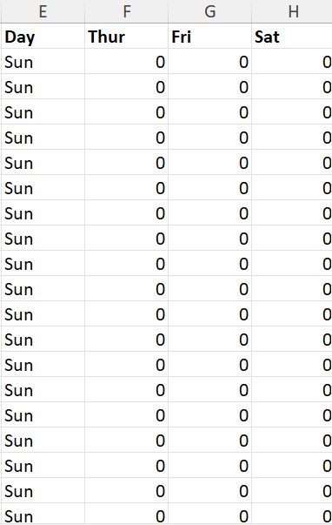
Clean the Data
To clean the data for “Day” column, since there are four options – Thur, Fri, Sat and Sun, we will need to add (n-1) columns, and in this case, it will be 4-1 = 3 columns. We will add an additional columns Thur, Fri, and Sat and apply the IF condition which =IF($E2=F$1, 1, 0) and we will get the results as follows

Slide 10
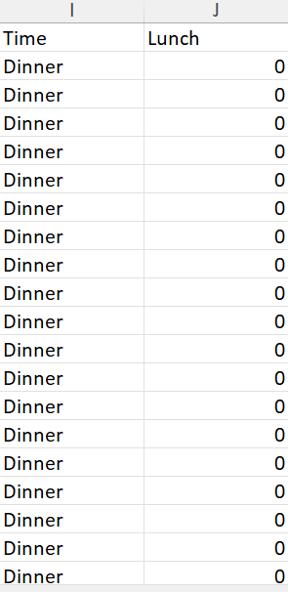
Clean the Data
To clean the data for “Time” column, since there are two options – Dinner and Lunch, we will need to add (n-1) columns, and in this case, it will be 2-1 = 1 column. We will add an additional columns Dinner and apply the IF condition which =IF($I2=J$1, 1, 0) and we will get the results as follows

Slide 11
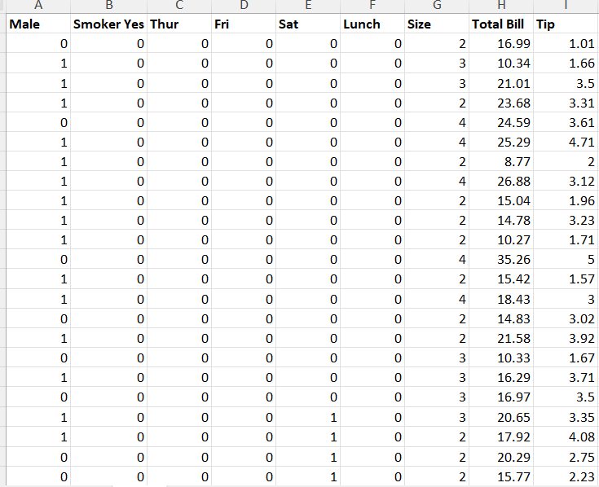
Clean the Data
Once all the non-numeric data is cleaned into “0” and “1”, we can now delete the columns with character data, and this is how the data looks after cleaning.

Slide 12
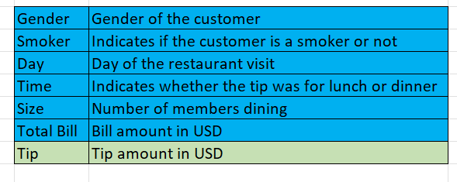
Variables
The variables highlighted in blue are dependent and the variables highlighted in green is independent

Slide 13
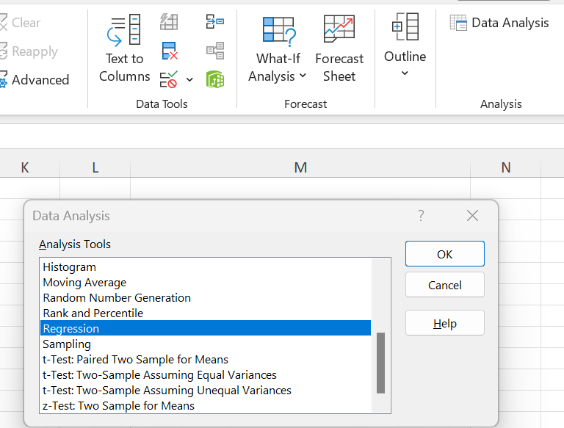
Perform Data Analysis using a Regression model
Using the “Data Analysis” plug in in Microsoft Excel, the Regression model is built as follows:

Slide 14
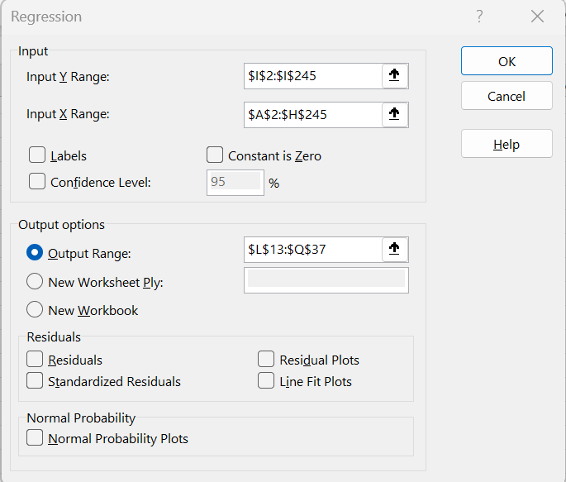
Perform Data Analysis using a Regression model
In the regression model, for “Input Y Range”, the independent variable column – Tip is selected excluding the header row as it contains character data; for “Input X Range”, the dependent variable columns Male, Smoker Yes, Thur, Fri, Sat, Dinner, Size, and Total Bill columns excluding the header is selected, and for the output range the same worksheet is selected.

Slide 15
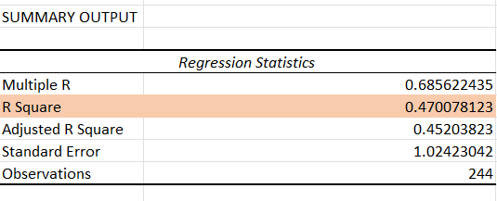
Perform Data Analysis using a Regression model
Regression Statistics of Summary Output, the value of R Square is between 0 and 1. If the value is near 0, then the error margin is considered very high as seen in the image.

Slide 16
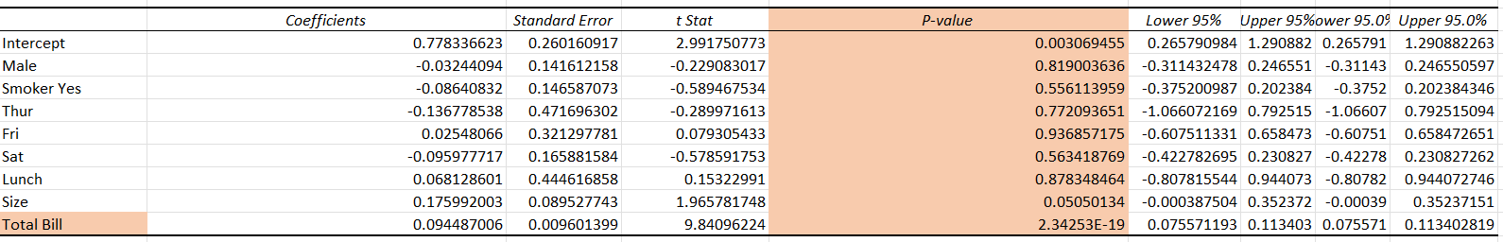
Perform Data Analysis using a Regression model
The “Total Bill” is the most significant variable for predicting the profit per the below image. All other variables excluding Intercept and Total Bill are not used because their values are very small, and their significance is not going to impact significantly
Therefore, for our regression analysis, only intercept and Total Bill will be taken into consideration for the equation y=mx+c, as it will help in tracking profit.

Slide 17
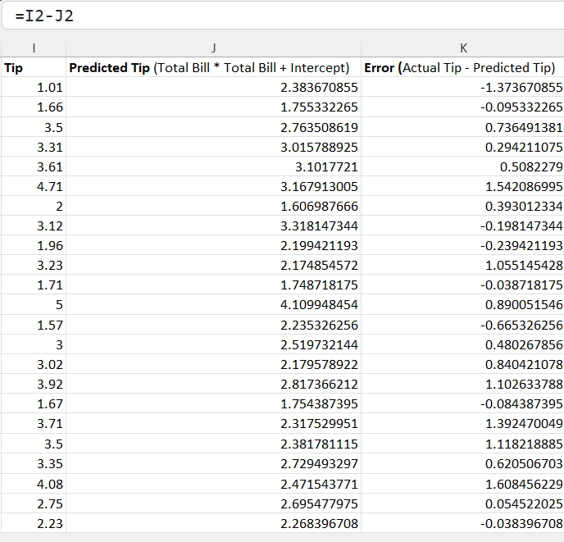
Perform Data Analysis using a Regression model
The “Error” is calculated by using the formula “Actual Tip – Predicted Tip”)

Slide 18
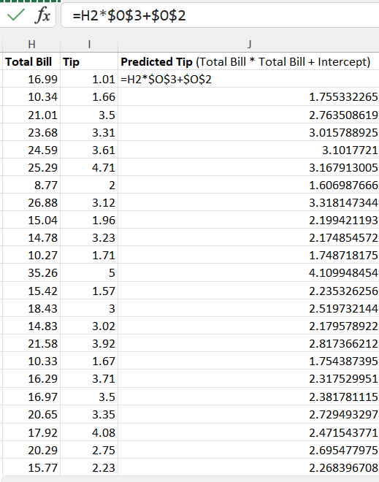
Perform Data Analysis using a Regression model
The “Predicted Tip” is calculated, by the formula = Total Bill (H2) * Total Bill ($O$3) + C ($O$2)

Slide 19
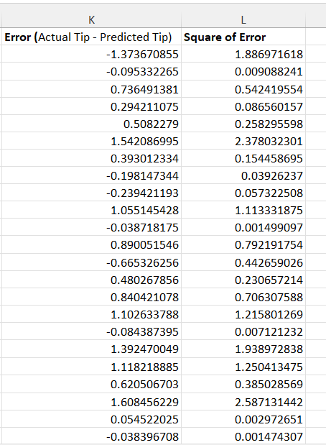
Perform Data Analysis using a Regression model
The “Square of error” will be calculated by multiply error by itself to avoid the value in negative (K2 * K2, and so on)

Slide 20
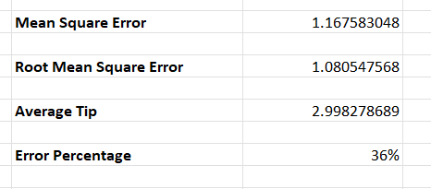
Perform Data Analysis using a Regression model
The “Mean Square Error (MSE)” is calculated which the AVERAGE of “Square of Errors”
The “Root Mean Square Error (RMSE) “ is calculated which is the SQRT of Mean Square Error (MSE)” .
The “Average Tip” is calculated which is the AVERAGE of “Actual Tip”
The “Error Percentage” is calculated which is “Root Mean Square Error (RMSE)” / “Average Tip”

